Slide 1
Clasificacíon de espectros mediante Machine Learning.
Jairo Andres Saavedra Alfonso
Universidad de los Andes
Astroandes
2019

Slide 2
The big data Problem in astronomy
Situation
Problem
Solutions
Validation
Summary

Slide 3
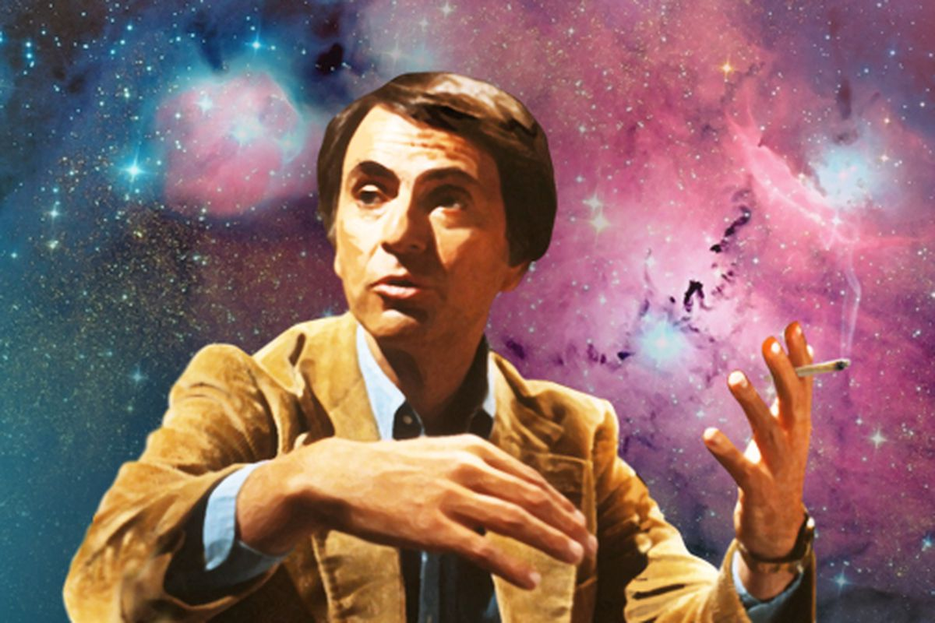
“The cosmos is within us. We are made of star-stuff. We are a way for the universe to know itself” - Carl Sagan, American Astronomer

Slide 4
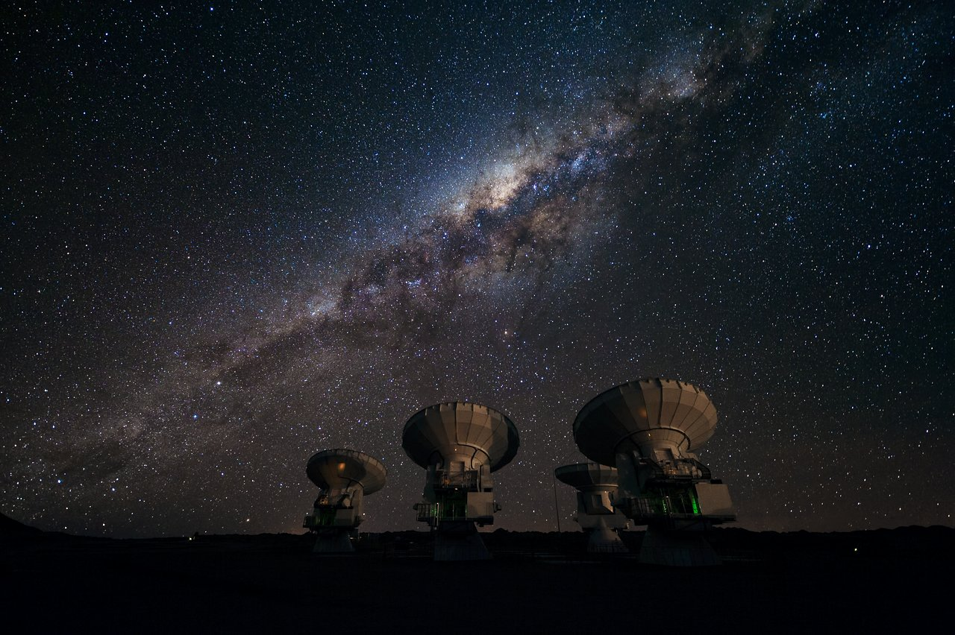

Slide 5
Situation
Too many data in the sky.

Slide 6
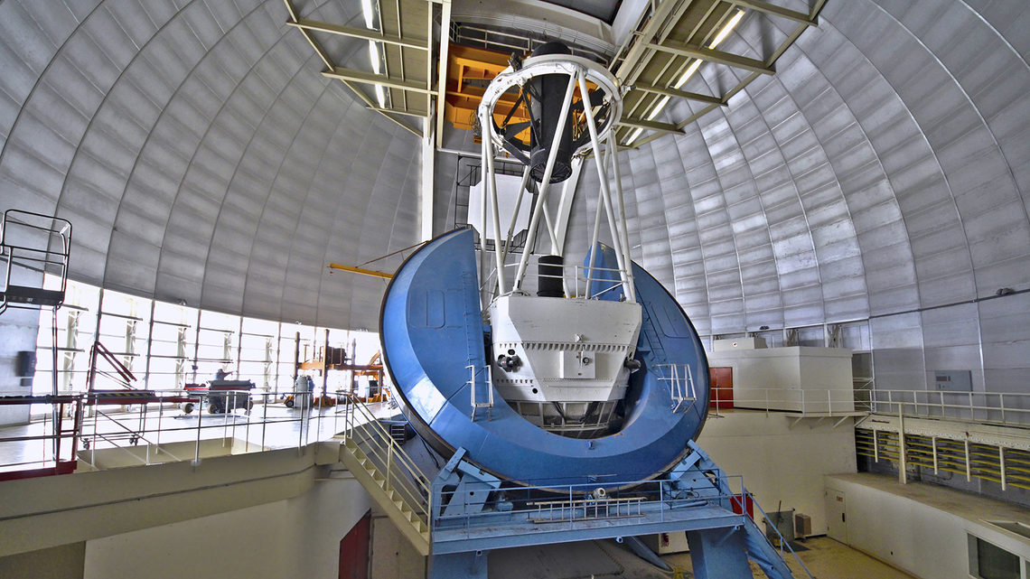
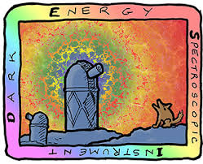
Problem
DESI Project
100 TB of data per year

Slide 7

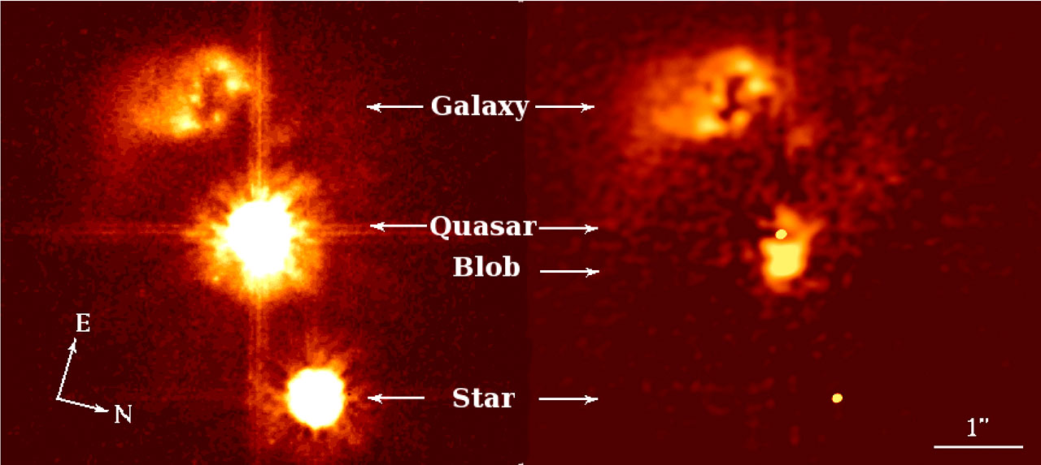
But, How?

Slide 8

Solution #1
PhD students
Pros:
- Human-expert accuracy.
Cons:
- Too expensive.
- Takes to much time.
- Human error.

Slide 9

Solution #2
Machine Learning
Algorithms:
- Learn from data
- Identify Patterns
- Make decisions

Slide 10

Neural Network
- Input Data
- Learning process
- Output Prediction

Slide 11
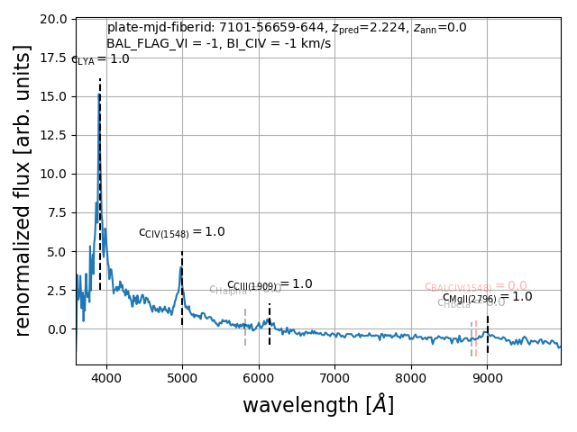
Input data: spectra
- Emission Lines
- Absorption Lines

Slide 12
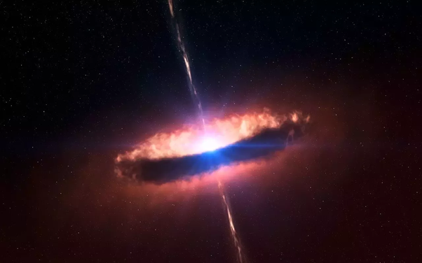
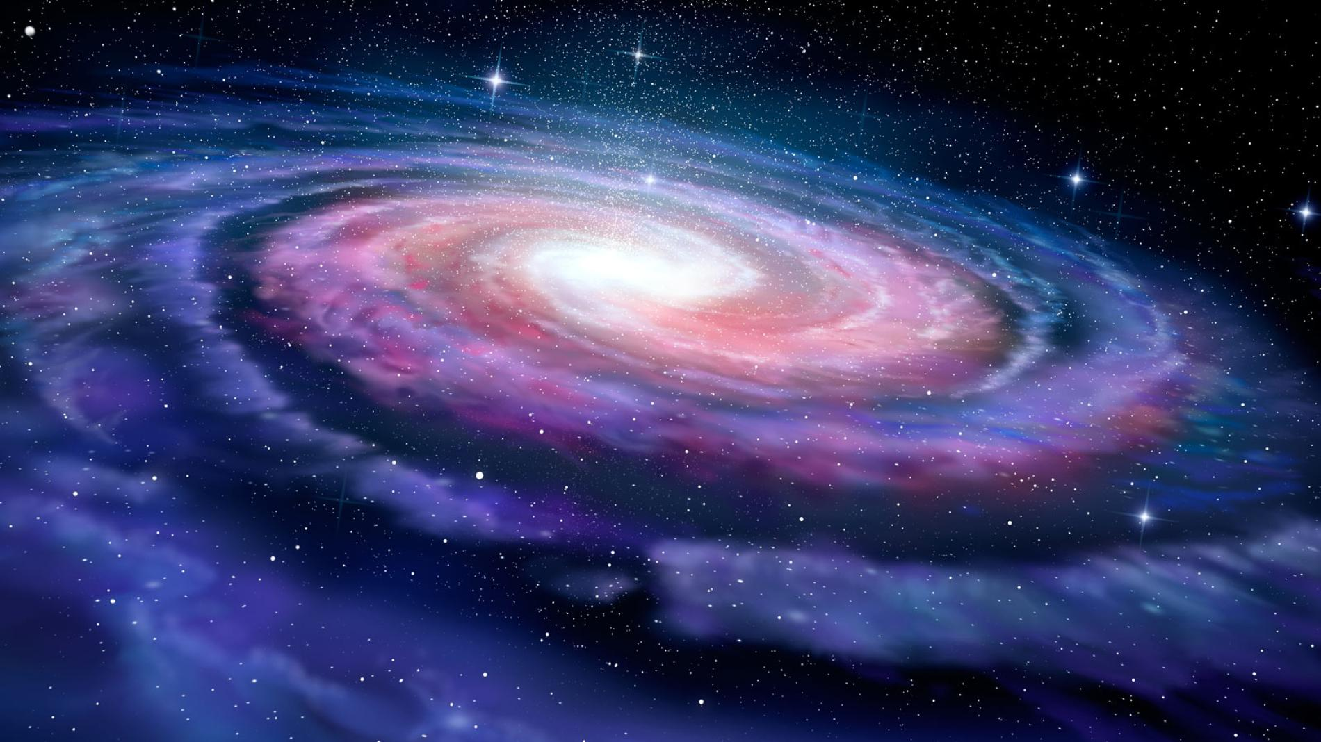
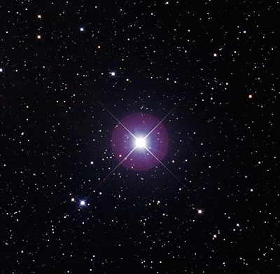
Final solution
Output Object
Input Spectra
Neural Network

Slide 13
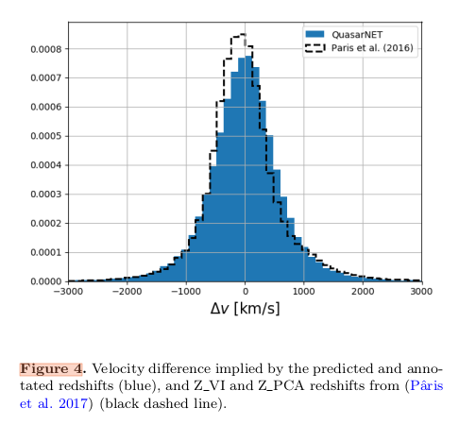
Evaluation
QuasarNET
Predict quasars:
99.51±0.03%

Slide 14
Summary
Problem: There is too much data available.
Solution: Machine Learning – Neural Network.
Evaluation: ML is a viable option in the big data problem.

